Slide 1

CODE NOVAX
Empowering the Next Era of Exoplanet Discovery
At Code Novax, we leverage cutting-edge AI to overcome the immense challenge of identifying exoplanets amidst vast astronomical datasets, transforming raw data into groundbreaking scientific discoveries.

Slide 2

AI-Powered Exoplanet Detection
Leveraging Machine Learning for Celestial Discoveries
This presentation explores the critical role of Artificial Intelligence in accelerating the discovery and classification of exoplanets, a core focus of the NASA Space Apps Challenge.

Slide 3


NASA's Exoplanet Hunting Missions
Three key missions have driven our search for worlds beyond our solar system, each pioneering new frontiers in astronomical observation.
Kepler
TESS
JWST
2009–2018
2018–Present
2021–Present
Pioneered transit photometry; confirmed thousands of exoplanets within a specific sky patch.
Surveys 85% of the sky for transiting planets around the nearest, brightest stars.
Provides unprecedented infrared observation to analyze exoplanet atmospheres and origins.

Slide 4


Transiting Exoplanet Survey Satellite (TESS)
TESS: The All-Sky Hunter
TESS is designed to perform an all-sky survey to discover exoplanets transiting bright, nearby stars. This proximity allows for easier follow-up observations by ground-based telescopes and JWST.
Systematically surveys nearly the entire sky.
Focuses on stars within 300 light-years of Earth.
Uses four wide-field cameras to cover large celestial areas.
The extensive data generated by TESS provides the primary input for modern AI-driven detection models.

Slide 5


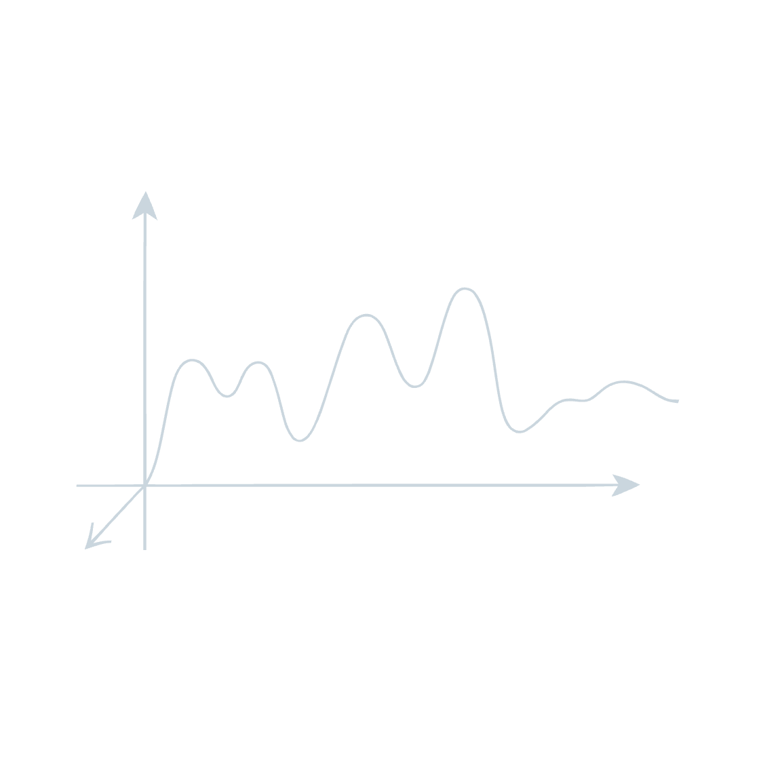
The Transit Method Explained
The primary technique for exoplanet discovery relies on observing the periodic dimming of a star's light.
Transit Detection
Light Curve Analysis
Key Parameters
As a planet passes in front of its host star (from our perspective), it momentarily blocks a fraction of the star's light.
Astronomers track this dip in stellar brightness, known as a light curve, to infer the presence and size of an orbiting exoplanet.
The depth of the dip indicates the planet's size, while the periodicity reveals its orbital period.

Slide 6

AI Model for Exoplanet Detection: The Neural Network Architecture
Convolutional Neural Networks (CNNs) are exceptionally suited for classifying complex light curve patterns.
Input layer
Light curve time-series
Neural Network Classification
Convolutional layers
Output layer
Exoplanet or false positive
Feature extraction filters
Dense hidden layers
Pooling & normalization
Pattern integration
Dimensionality reduction
1
2
3
Input Layer
Hidden Layers
Output Layer
Raw light curve data from telescopes like TESS.
Convolutional filters extract deep, hierarchical features from the time-series data.
Binary classification: Exoplanet Candidate (99%) or False Positive (1%).

Slide 7

Exoplanet Candidate Pipeline: AI in Action
The journey from raw stellar data to a confirmed exoplanet is a multi-stage process, significantly accelerated and refined by AI.
Raw TESS Data
Preprocessing
AI Inference
Candidate Review
This streamlined pipeline allows astronomers to efficiently sift through vast datasets and focus on the most promising candidates, dramatically increasing the pace of discovery.

Slide 8




From Data to Discovery: The ML Workflow
Implementing AI into exoplanet research requires a structured pipeline to ensure reliable and efficient candidate identification.
Data Collection
Preprocessing
Acquiring raw photometric data from space missions (e.g., TESS, Kepler).
Cleaning data, normalizing flux, and removing noise/systematics.
Model Training
Deployment
Using annotated datasets of confirmed and false positives to train the CNN or Random Forest algorithms.
Integrating the trained model into a web interface for real-time predictions and researcher access.

Slide 9
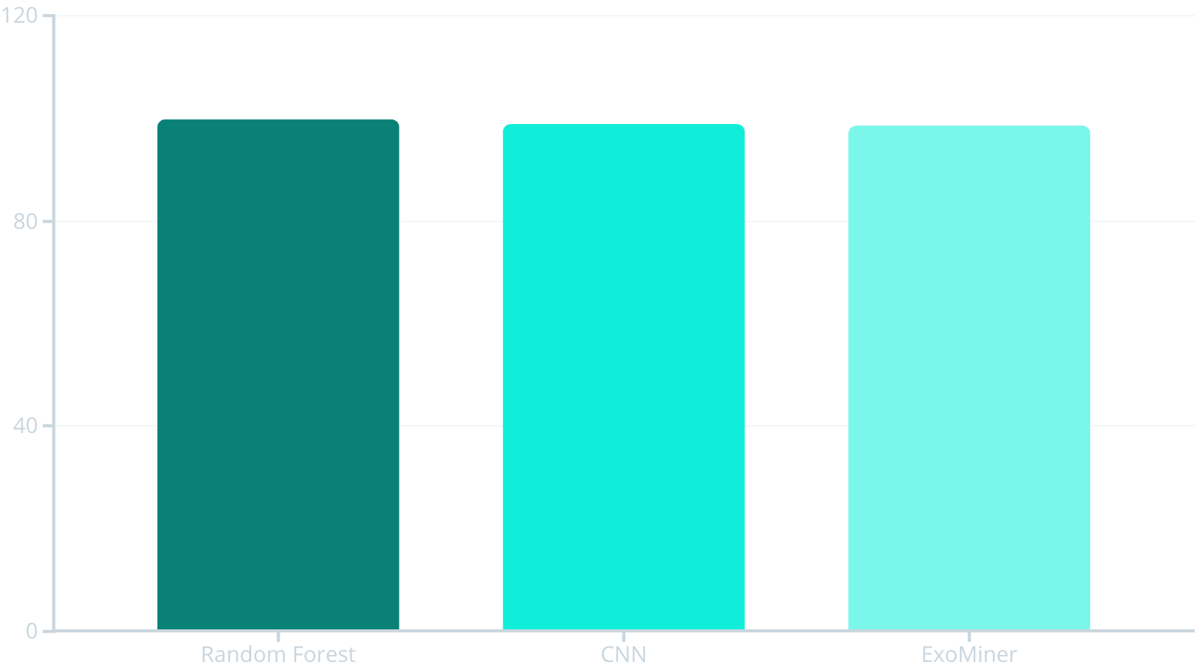
Achieving High Accuracy in Classification
Advanced ML models significantly reduce the manual effort required for vetting candidates, often surpassing human accuracy.
Random Forest
Highly effective on well-defined features, achieving near-perfect classification accuracy.
CNNs (Deep Learning)
Excel at learning complex features directly from the raw light curve image representations.
ExoMiner Recall
Prioritizes finding true positives (93.6% recall) to maximize new discoveries.
These high accuracy rates dramatically speed up the verification process for potential new worlds.

Slide 10








Under the Hood: Technical Implementation Details
Robust data handling and feature engineering are crucial to building reliable exoplanet detection models.
SMOTE for Balance
Feature Engineering
Synthetic Minority Over-sampling Technique to address the highly imbalanced dataset (few exoplanets, many non-transits).
Creation of meaningful inputs like transit duration ratio and depth variability for better model performance.
Convolutional Neural Network (CNN)
Random Forest
An ensemble method leveraging decision trees for robust and fast classification of candidates.
Used to directly analyze the 2D 'image' representation of the folded light curve.

Slide 11




User-Friendly Interface and Deployment
A successful project requires not just a powerful model, but also accessible tools for the end-user researcher.
Real-Time Predictions
Instantly score new TESS candidates as they become available.
Visualization Tools
The web interface acts as a crucial bridge between advanced AI insights and human verification.
Interactive light curves, feature importance plots, and candidate rankings.
Cloud Deployment
Containerization using Docker ensures portability and scalability on platforms like AWS or Google Cloud.

Slide 12


The Future of Discovery
AI is preparing the ground for the next generation of space telescopes, enabling discoveries we can only imagine today.
Roman Space Telescope (Launch ~2027)
AI will be vital for processing the massive data volume and identifying exoplanets using microlensing techniques.
Multi-Modal Learning
Integrating light curve data with radial velocity, direct imaging, and atmospheric composition data for richer classification.
Broader Applications
Applying these robust AI methods to other astronomical challenges, from stellar flares to asteroid tracking.

Slide 13



Thank You!
We appreciate your time and interest in CODE NOVAX. Together, we're pushing the boundaries of exoplanet discovery and charting the future of space exploration.

